Slide 1
Online GPS II/MAPP
Meetings 1 – 10

Slide 2
Meeting 10 Ending and Beginnings

Slide 3
License Rights to OCFS
Center for Development of Human Services, Institute for Community Health Promotion, SUNY Buffalo State acknowledges the State of New York’s and the Office of Children and Family Services’ royalty-free, non-exclusive and revocable license to reproduce, publish, distribute, or otherwise use any and all material herein for the limited purpose of training GPSII/MAPP Leaders and for as long as such materials and such training are deemed appropriate by NYS OCFS.
The Children’s Alliance of Kansas (CAOK) is the current national owner of the copyrighted “toolbox” of MAPP programs. NYS Office of Children and Family Services (NYS OCFS)/Center for Development of Human Services (CDHS) has permission from CAOK to provide MAPP programs (GPSII/MAPP, Caring For Our Own, Deciding Together, Shared Parenting, Mini-MAPP, and Child Sexual Abuse) to certify leaders through leader certification workshops and directly to foster/adoptive parents in New York State.
In order to better meet the needs of children and families in New York State, PS-MAPP was revised in 2004 and renamed GPSII/MAPP. Further revisions were made in 2005 after considering the feedback from MAPP Leaders throughout the state, and minor revisions and reformatting occurred in 2009. Significant revisions to the content and updating to reflect best practice and legal changes in New York State were made and approved by NYS OCFS in 2012 for this edition.
© 2009 Children’s Alliance of Kansas. Revised with permission NYS OCFS.

Slide 4
Welcome Panel Members
Placeholder for panel member names & roles

Slide 5
Rules of the Road
Placeholder

Slide 6
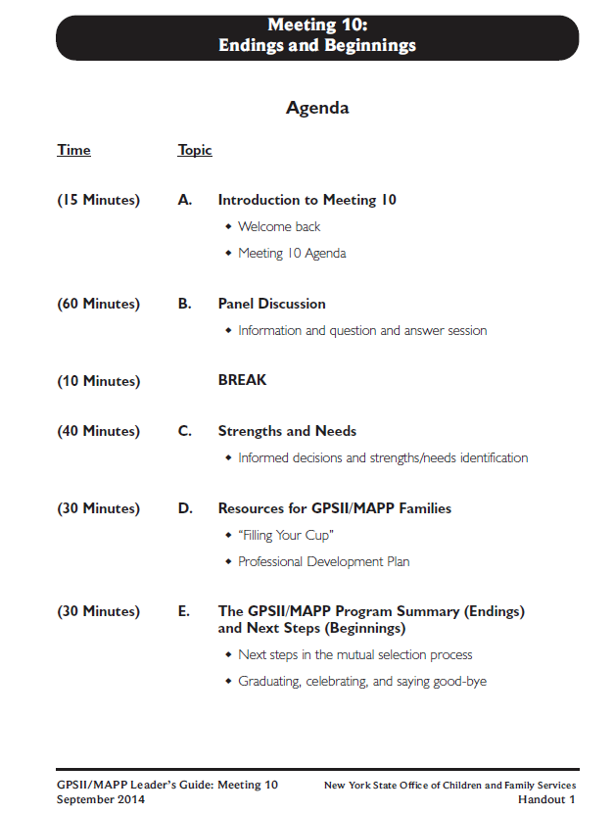

Slide 7
Instructions for Final Strengths/Needs Discussion
Share your decision- to foster, to adopt, to foster/adopt, or to help children and families in another way.
Describe what helped you make your decision.
For those who have decided to be foster/adoptive parents, how have your ideas about the type of child who would fit into your family changed or remained the same?
What do you see as your new strengths after participating in the GPSII/MAPP program?
What do you see as your needs after participating in the GPSII/MAPP program?

Slide 8
Water = My energy to share with a child

Slide 9
What do you notice about this child?

Slide 10
What might have caused this child to develop a protective shell?

Slide 11
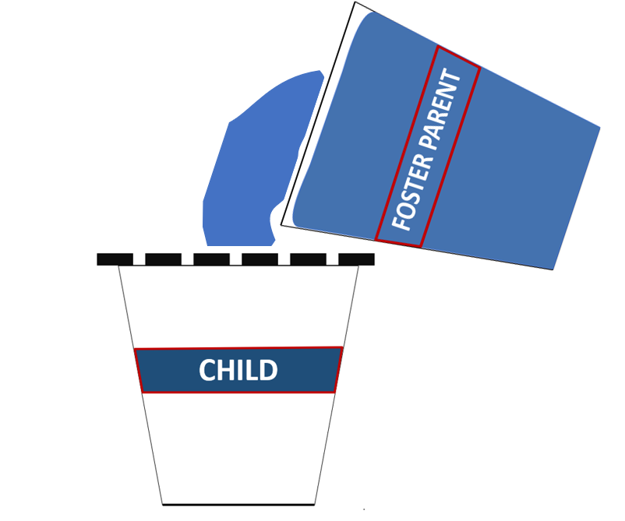

Slide 12
What’s happening here?

Slide 13
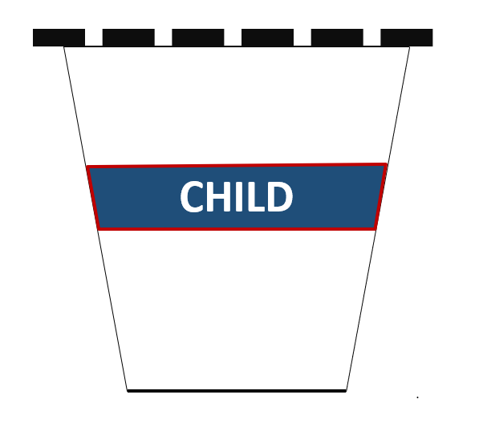

Slide 15
Other
Foster Parents
Time
Alone
Friends
Agency
Laughter
Family

Slide 17
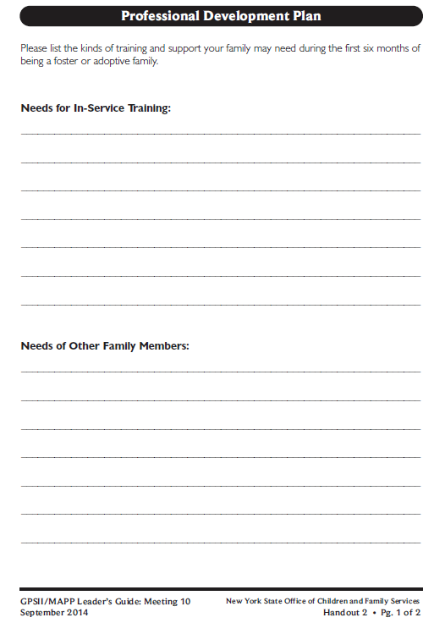
Let’s look at: Handout 2 Professional Development Plan

Slide 18
Next Steps:
Placeholder

Slide 19
It’s Time for a PIP!
Partnership
In
Parenting Experience

